Slide 1
Field Momentum and Structured Light
Masud Mansuripur
College of Optical Sciences, University of Arizona, Tucson
Quantum Field Framework for Structured Light Interactions
Banff International Research Station (BIRS), Calgary, Canada, April 24, 2017

Slide 2
Facts and Misconceptions
Advanced applications require accurate determination of electro-magnetic (EM) force & torque distributions within material media.
Material media consist of electrical charges and currents, as well as electric and magnetic dipoles. (These are known as “sources.”)
Maxwell’s equations suffice to calculate the E and B (or H) fields.
The Lorentz force law $f=q(E+V×B)$ is all we need to calculate electromagnetic force & torque distributions within material media.
Electromagnetic stress tensor is all we need to calculate…
All EM stress tensors (Maxwell-Lorentz, Minkowski, Abraham, Chu, Einstein-Laub) are equivalent.
The correct stress tensor must be consistent with conservation laws and special relativity, as well as with experimental observations.
2/14

Slide 3
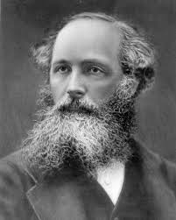
Maxwell’s macroscopic equations (SI)
James Clerk Maxwell (1831-1879)
∇ ⋅ D = ρ_{free}
∇ × H = J_{free} + ∂ D/∂ t
∇ × E = − ∂ B/∂ t
∇ · B = 0
Electric displacement D is related to polarization density P:
D = ε_{o}E + P = ε_{o}(1+χ_{e})E = ε_{o}ε E
Magnetic induction B is related to magnetization density M:
B = μ_{o}H + M = μ_{o}(1+χ_{m})H = μ_{o}μ H
ρ_{free}, J_{free}, P, and M (r, t) are the sources of radiation
E(r,t) and H(r,t) are the radiated fields
Exact equations (mathematically).
No small-scale averaging required.
Reducible to microscopic equations.
3/14

Slide 4
P (r, t) and M (r, t) are replaced by equivalent bound-charge and bound-current densities
$$ρ_{e−bound}=−∇∙P(r, t)$$
$J_{e−bound}^{\left(pol\right)}=∂P(r,t)/∂t$
$J_{e−bound}^{\left(mag\right)}=μ_{0}^{−1}∇×M$
$$ε_{0}∇∙E=ρ_{free}+ρ_{e−bound}$$
$$∇×B=μ_{0}\left[J_{free}+J_{e−bound}^{\left(pol\right)}+J_{e−bound}^{\left(mag\right)}\right]+μ_{0}ε_{0}∂E/∂t$$
$$∇×E=− ∂B/∂t$$
$$∇∙B = 0$$
$$ρ_{total}$$
$$J_{total}$$
4/14

Slide 5
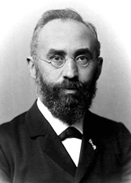
Lorentz Force (and Torque) in the Presence of P (r, t) and M(r, t)
E
$$f=q(E+V×B)$$
V
q
Hendrik Lorentz (1853-1928)
B
F(r, t) = ρ _{total}(r, t)E(r, t) + J_{total}(r, t) × B(r, t)
Force density
Charge density
Current density
T (r, t) = (r − r_{o}) × F (r, t)
Torque density
Reference point
Force density
5/14

Slide 6
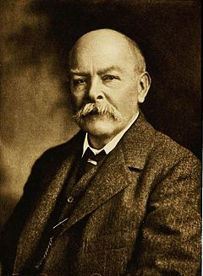
Electromagnetic Energy: Poynting’s Vector
$$S\left(r,t\right)=E\left(r,t\right)×H\left(r,t\right)$$
$E∙\left(∇×H=J_{free}+{∂D}/{∂t}\right)$
$$−H∙\left(∇×E=−{∂B}/{∂t}\right)$$
John Henry Poynting
(1852-1914)
$$∇∙S+{∂\left(½ε_{0}E∙E+½μ_{0}H∙H\right)}/{∂t}+E∙J_{free}+E∙\left({∂P}/{∂t}\right)+H∙\left({∂M}/{∂t}\right)=0$$
Field energy density
Energy exchange rate between fields and media
6/14

Slide 7
The Stress Tensors of Lorentz, Minkowski, Abraham, Chu, and Einstein & Laub
$${\overset{⃡}{𝓣}}_{L}\left(r,t\right)=½\left(ε_{0}E∙E+μ_{0}^{−1}B∙B\right)\overset{⃡}{I}−ε_{0}EE−μ_{0}^{−1}BB$$
$${\overset{⃡}{𝓣}}_{M}\left(r,t\right)=½\left(D∙E+B∙H\right)\overset{⃡}{I}−DE−BH$$
$${\overset{⃡}{𝓣}}_{A}\left(r,t\right)=½\left(D∙E+B∙H\right)\overset{⃡}{I}−DE−BH$$
$${\overset{⃡}{𝓣}}_{Chu}\left(r,t\right)=½\left(ε_{0}E∙E+μ_{0}H∙H\right)\overset{⃡}{I}−ε_{0}EE−μ_{0}HH$$
$${\overset{⃡}{𝓣}}_{EL}\left(r,t\right)=½\left(ε_{0}E∙E+μ_{0}H∙H\right)\overset{⃡}{I}−DE−BH$$
$$\overset{⃡}{∇}∙\overset{⃡}{𝓣}\left(r,t\right)+∂_{t}𝓹\left(r,t\right)+f(r,t)=0$$
Identical
EM momentum-density
EM force-density
7/14

Slide 8
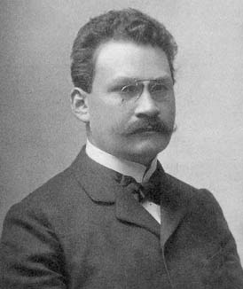
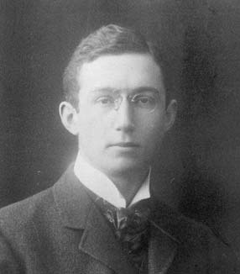
Electromagnetic momentum-density
$$𝓹_{L}\left(r,t\right)=ε_{0}E×B$$
$$𝓹_{M}\left(r,t\right)=D×B$$
$$𝓹_{A}\left(r,t\right)=𝓹_{Chu}=𝓹_{EL}=E×H/c^{2}$$
$$f_{A}\left(r,t\right)=f_{M}\left(r,t\right)+∂_{t}\left(D×B−E×H/c^{2}\right)$$
Maxwell-Lorentz (Livens) Momentum
Minkowski Momentum
Abraham Momentum
Abraham force-density
Minkowski force-density
Abraham force
Hermann Minkowski
(1864 – 1909)
Max Abraham
(1875 – 1922)
8/14

Slide 9
Electromagnetic force- and torque-density
Lorentz:
$$f_{L}\left(r,t\right)=\left(ρ_{free}−∇∙P\right)E+\left(J_{free}+∂_{t}P+μ_{0}^{−1}∇×M\right)×B$$
$$τ_{L}\left(r,t\right)=r×f_{L}\left(r,t\right)$$
Minkowski:
$$f_{M}\left(r,t\right)=ρ_{free}E+J_{free}×B$$
$+\left[\left(P∙∇\right)E+P×\left(∇×E\right)−½∇(P∙E)\right]$
$+\left[\left(M∙∇\right)H+M×\left(∇×H\right)−½∇(M∙H)\right]$
$$τ_{M}\left(r,t\right)=r×f_{M}\left(r,t\right)+P×E+M×H$$
Hendrik Lorentz (1853-1928)
9/14

Slide 10
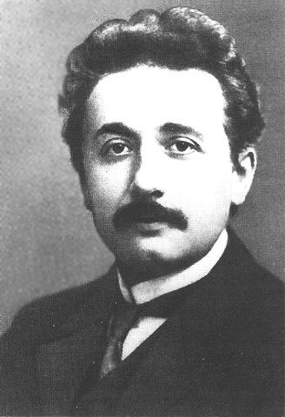
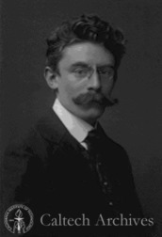
Electromagnetic force and torque-density
Chu:
$$f_{Chu}\left(r,t\right)=\left(ρ_{free}−∇∙P\right)E+\left(J_{free}+∂_{t}P\right)×μ_{0}H$$
$−\left(∇∙M\right)H−∂_{t}M×ε_{0}E$
$$τ_{Chu}\left(r,t\right)=r×f_{Chu}\left(r,t\right)$$
Lan Jen Chu (1913-1973)
Einstein-Laub:
$$f_{EL}\left(r,t\right)=ρ_{free}E+J_{free}×μ_{0}H+\left(P∙∇\right)E+∂_{t}P×μ_{0}H$$
$+\left(M∙∇\right)H−∂_{t}M×ε_{0}E$
$$τ_{EL}\left(r,t\right)=r×f_{EL}\left(r,t\right)+P×E+M×H$$
Albert Einstein (1879-1955)
Jakob Laub
(1884-1962)
10/14

Slide 11
The Balazs “Thought Experiment” (1953)
x
cτ
E = mc²
L
c
( − 1)L
μ , ε
V_{g}
M_{o}
Anti-reflection coating
z
Agrees with Abraham momentum (Abraham, Chu, Einstein-Laub).
Disagrees with Livens momentum (Maxwell-Lorentz stress tensor).
Disagrees with Minkowski momentum (Minkowski stress tensor).
11/14

Slide 12
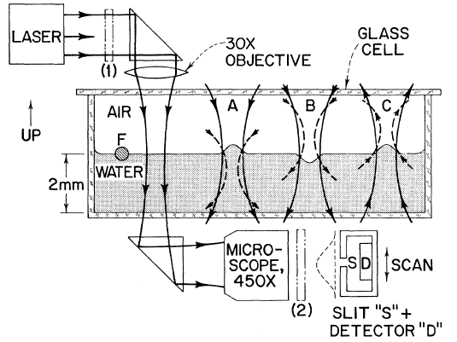
Ashkin-Dziedzic Experiment (Bulge on the liquid surface)
Disagrees with Maxwell-Lorentz and Chu
Agrees with Einstein-Laub
12/14

Slide 13
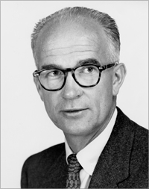
Hidden Momentum
^
m_{o}= μ_{o} I_{o} A z
^
·
z
I_{o}
+
William Shockley (1910-1989)
y
Point charge
E_{o}
S_{hidden} = M × E_{o}/μ_{o}
p_{hidden} = ε_{o} M × E_{o}
+
E_{o}
x
13/14

Slide 14
Conclusions
Maxwell’s macroscopic equations are exact and self-consistent; they are also superior to microscopic equations.
The Lorentz law of force is incompatible with special relativity and with the conservation laws − unless hidden energy and hidden momentum are taken into account. (It also disagrees with certain experimental observations.)
The correct force law appears to be that of Einstein and Laub.
Electromagnetic energy flux is given by the Poynting vector $S(r,t)=E×H$.
Electromagnetic momentum-density is $𝓹_{A}(r, t)=S(r, t)/c2$ (Abraham).
Electromagnetic angular-momentum-density is $𝓛\left(r, t\right)=r×S(r, t)/c2$.
The above postulates are complete and consistent with Special Relativity, and with the laws of conservation of energy, momentum, and angular momentum. They also agree with the existing body of experimental observations.
14/14

